Slide 1

Unveiling Udemy Courses: An Exploratory Journey
Welcome to "Unveiling Udemy Courses: An Exploratory Journey." - I'm take you on a deep dive into the world of Udemy courses and share some fascinating insights .

Slide 2

Navigating Udemy's Sea of Knowledge
Dataset Overview:
- Let's start with our dataset, which is packed with valuable information about Udemy courses.
- We have details like course titles, number of subscribers, categories, and more.
- Throughout the analysis, we've meticulously navigated through this sea of knowledge using various techniques and tools to extract meaningful insights.

Slide 3
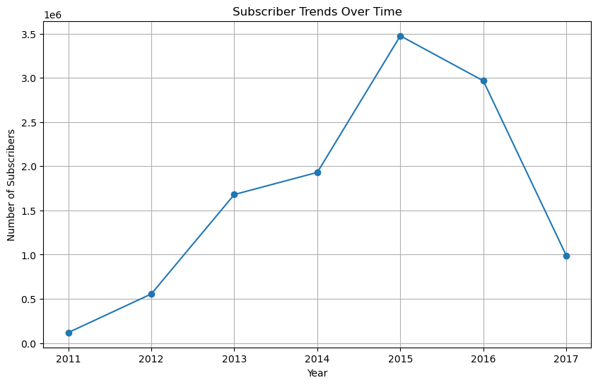
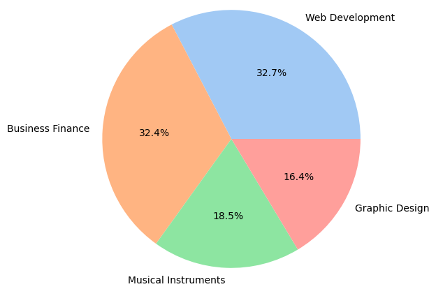
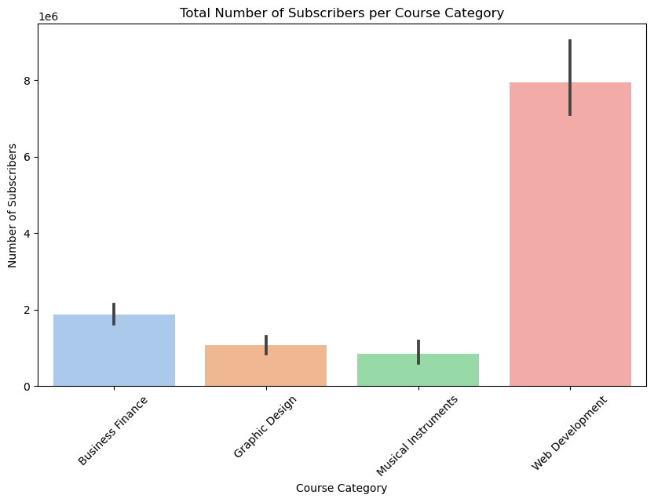
Discoveries and Insights - Key Discoveries: - Identified the most popular course categories that have captured learners' interests. - Observed intriguing trends in subscriber numbers over time, providing valuable insights into user behaviors. - Additionally, understanding of learners' preferences and behaviors through our analysis. - To better illustrate these discoveries, let's take a look at some visualizations.

Slide 4

Predictions and Future Direction Charting the Course Ahead
- Based on our findings, we've formulated some predictions and insights for the future:
- The anticipate significant growth in certain course categories as demand continues to evolve.
- Also foresee changes in user engagement and behavior, reflecting broader shifts in online learning trends.
- Future Directions:
- Looking ahead, there are exciting opportunities and challenges on the horizon for platforms like Udemy.

Slide 5

Anchors Away: Let's Set Sail! Call to Action:
In conclusion, the exploratory journey through the Udemy courses dataset has been both enlightening and exhilarating. - The analysis uncovered valuable insights that can inform strategic decisions and drive future success in the online learning landscape.

